Slide 1


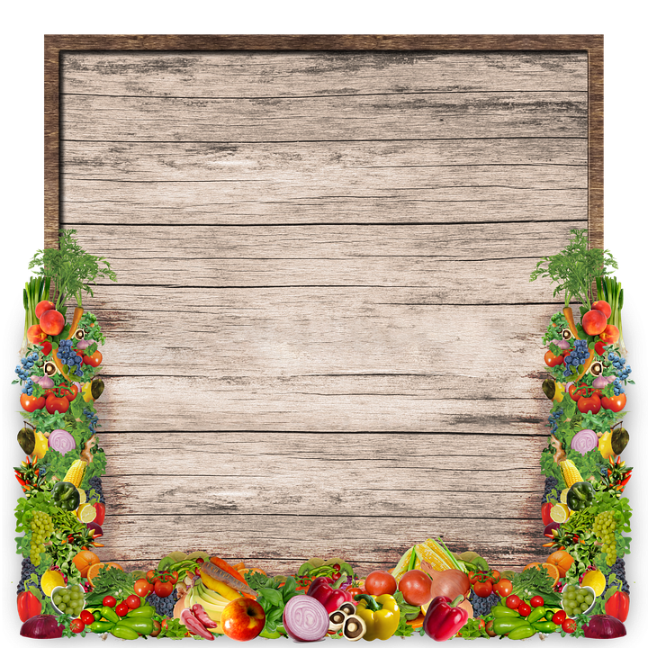


WHAT DO YOU WANT TO DO TODAY?
COOKING
GAMES

Slide 2
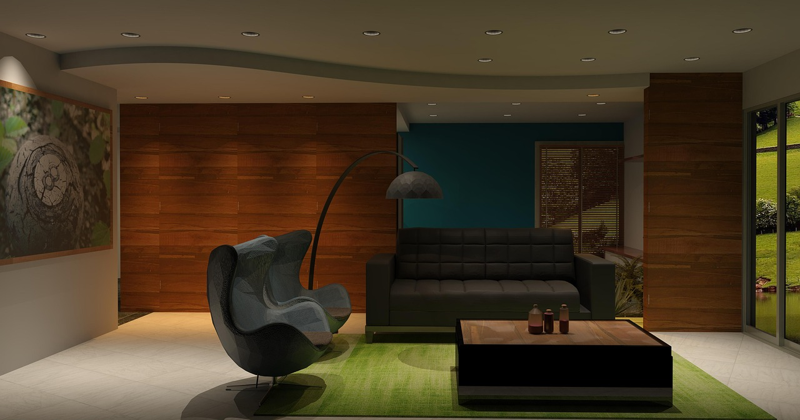
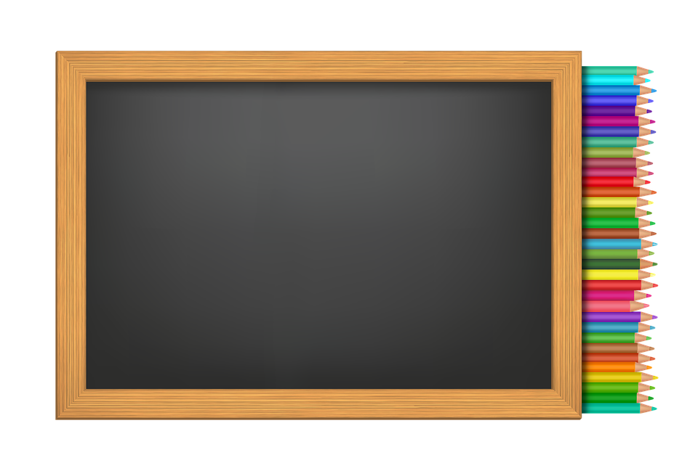
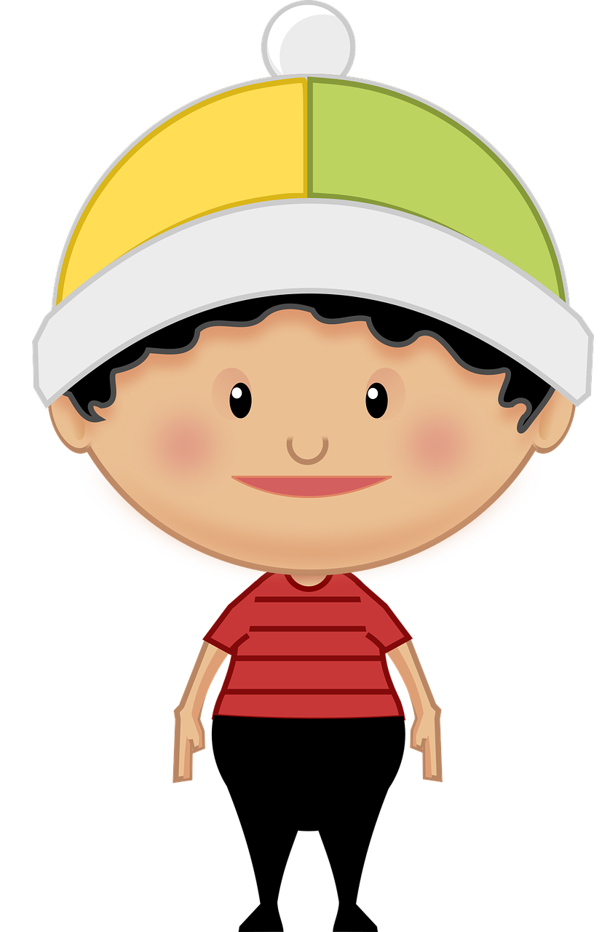
Match Colors

Slide 3
Hey There!
Match The Colours.

Slide 4
Hey There!
Match The Colours.

Slide 5
Hey There!
Match The Colours.

Slide 6
Hey There!
Match The Colours.

Slide 7
Hey There!
Match The Colours.

Slide 8
Hey There!
Match The Colours.

Slide 9
Hey There!
Match The Colours.

Slide 10
Hey There!
Match The Colours.

Slide 11
Hey There!
Match The Colours.

Slide 12


GREAT JOB !

Slide 13

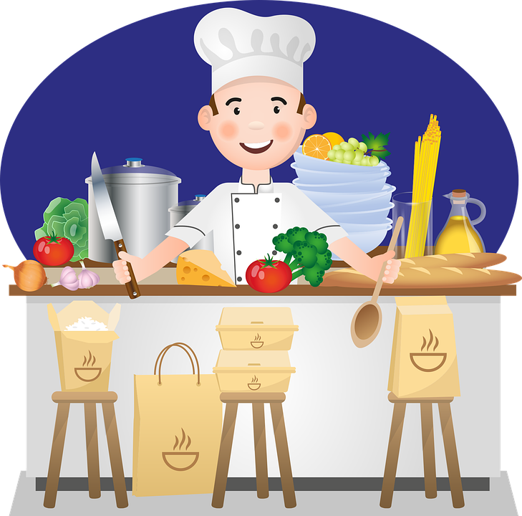
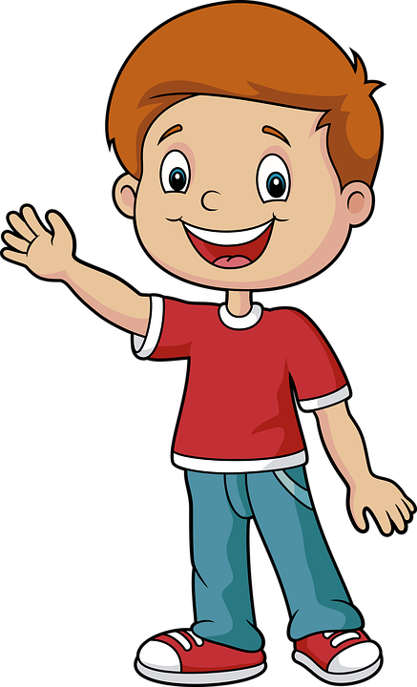
Hey Chef, what are you cooking today ?

Slide 14
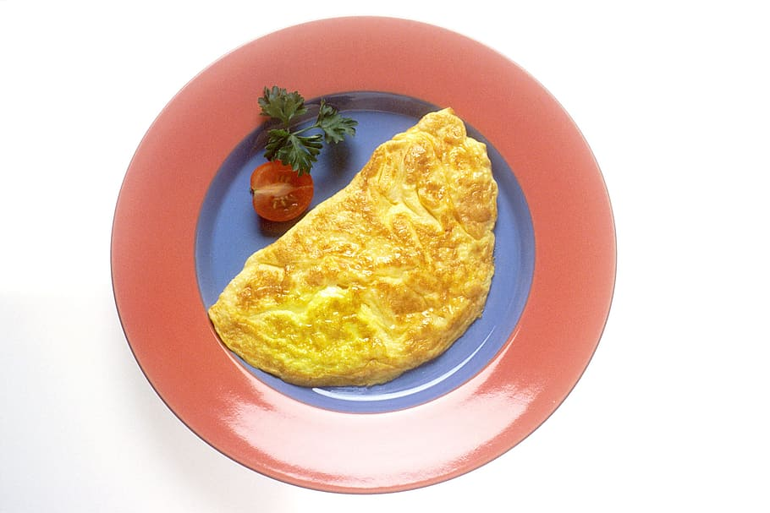
Hey Jeff! Today we are making scrambled eggs.

Slide 15
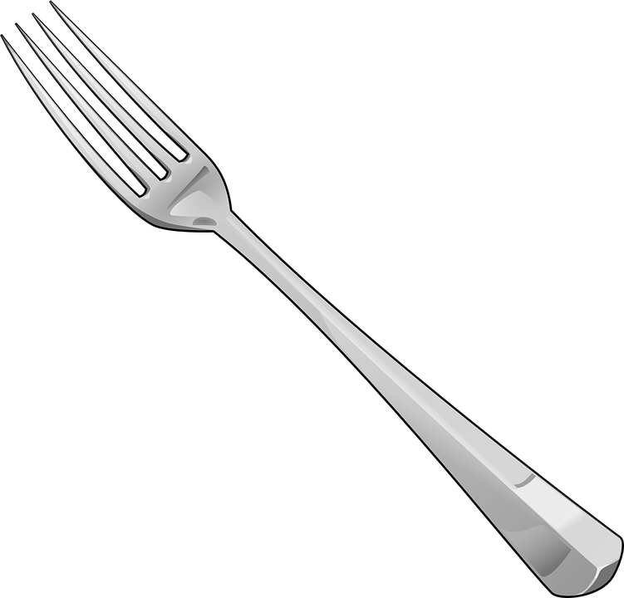
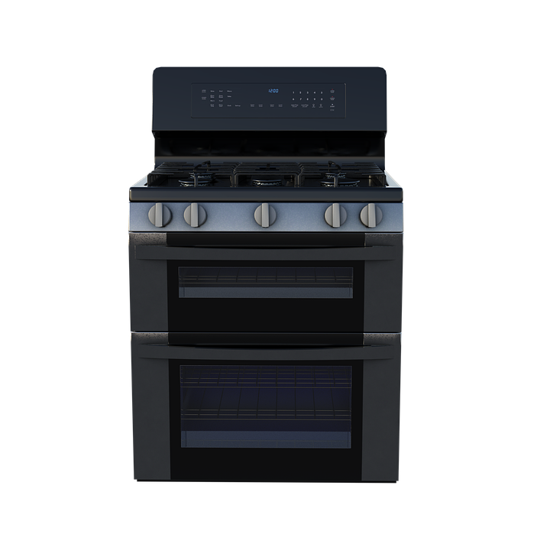
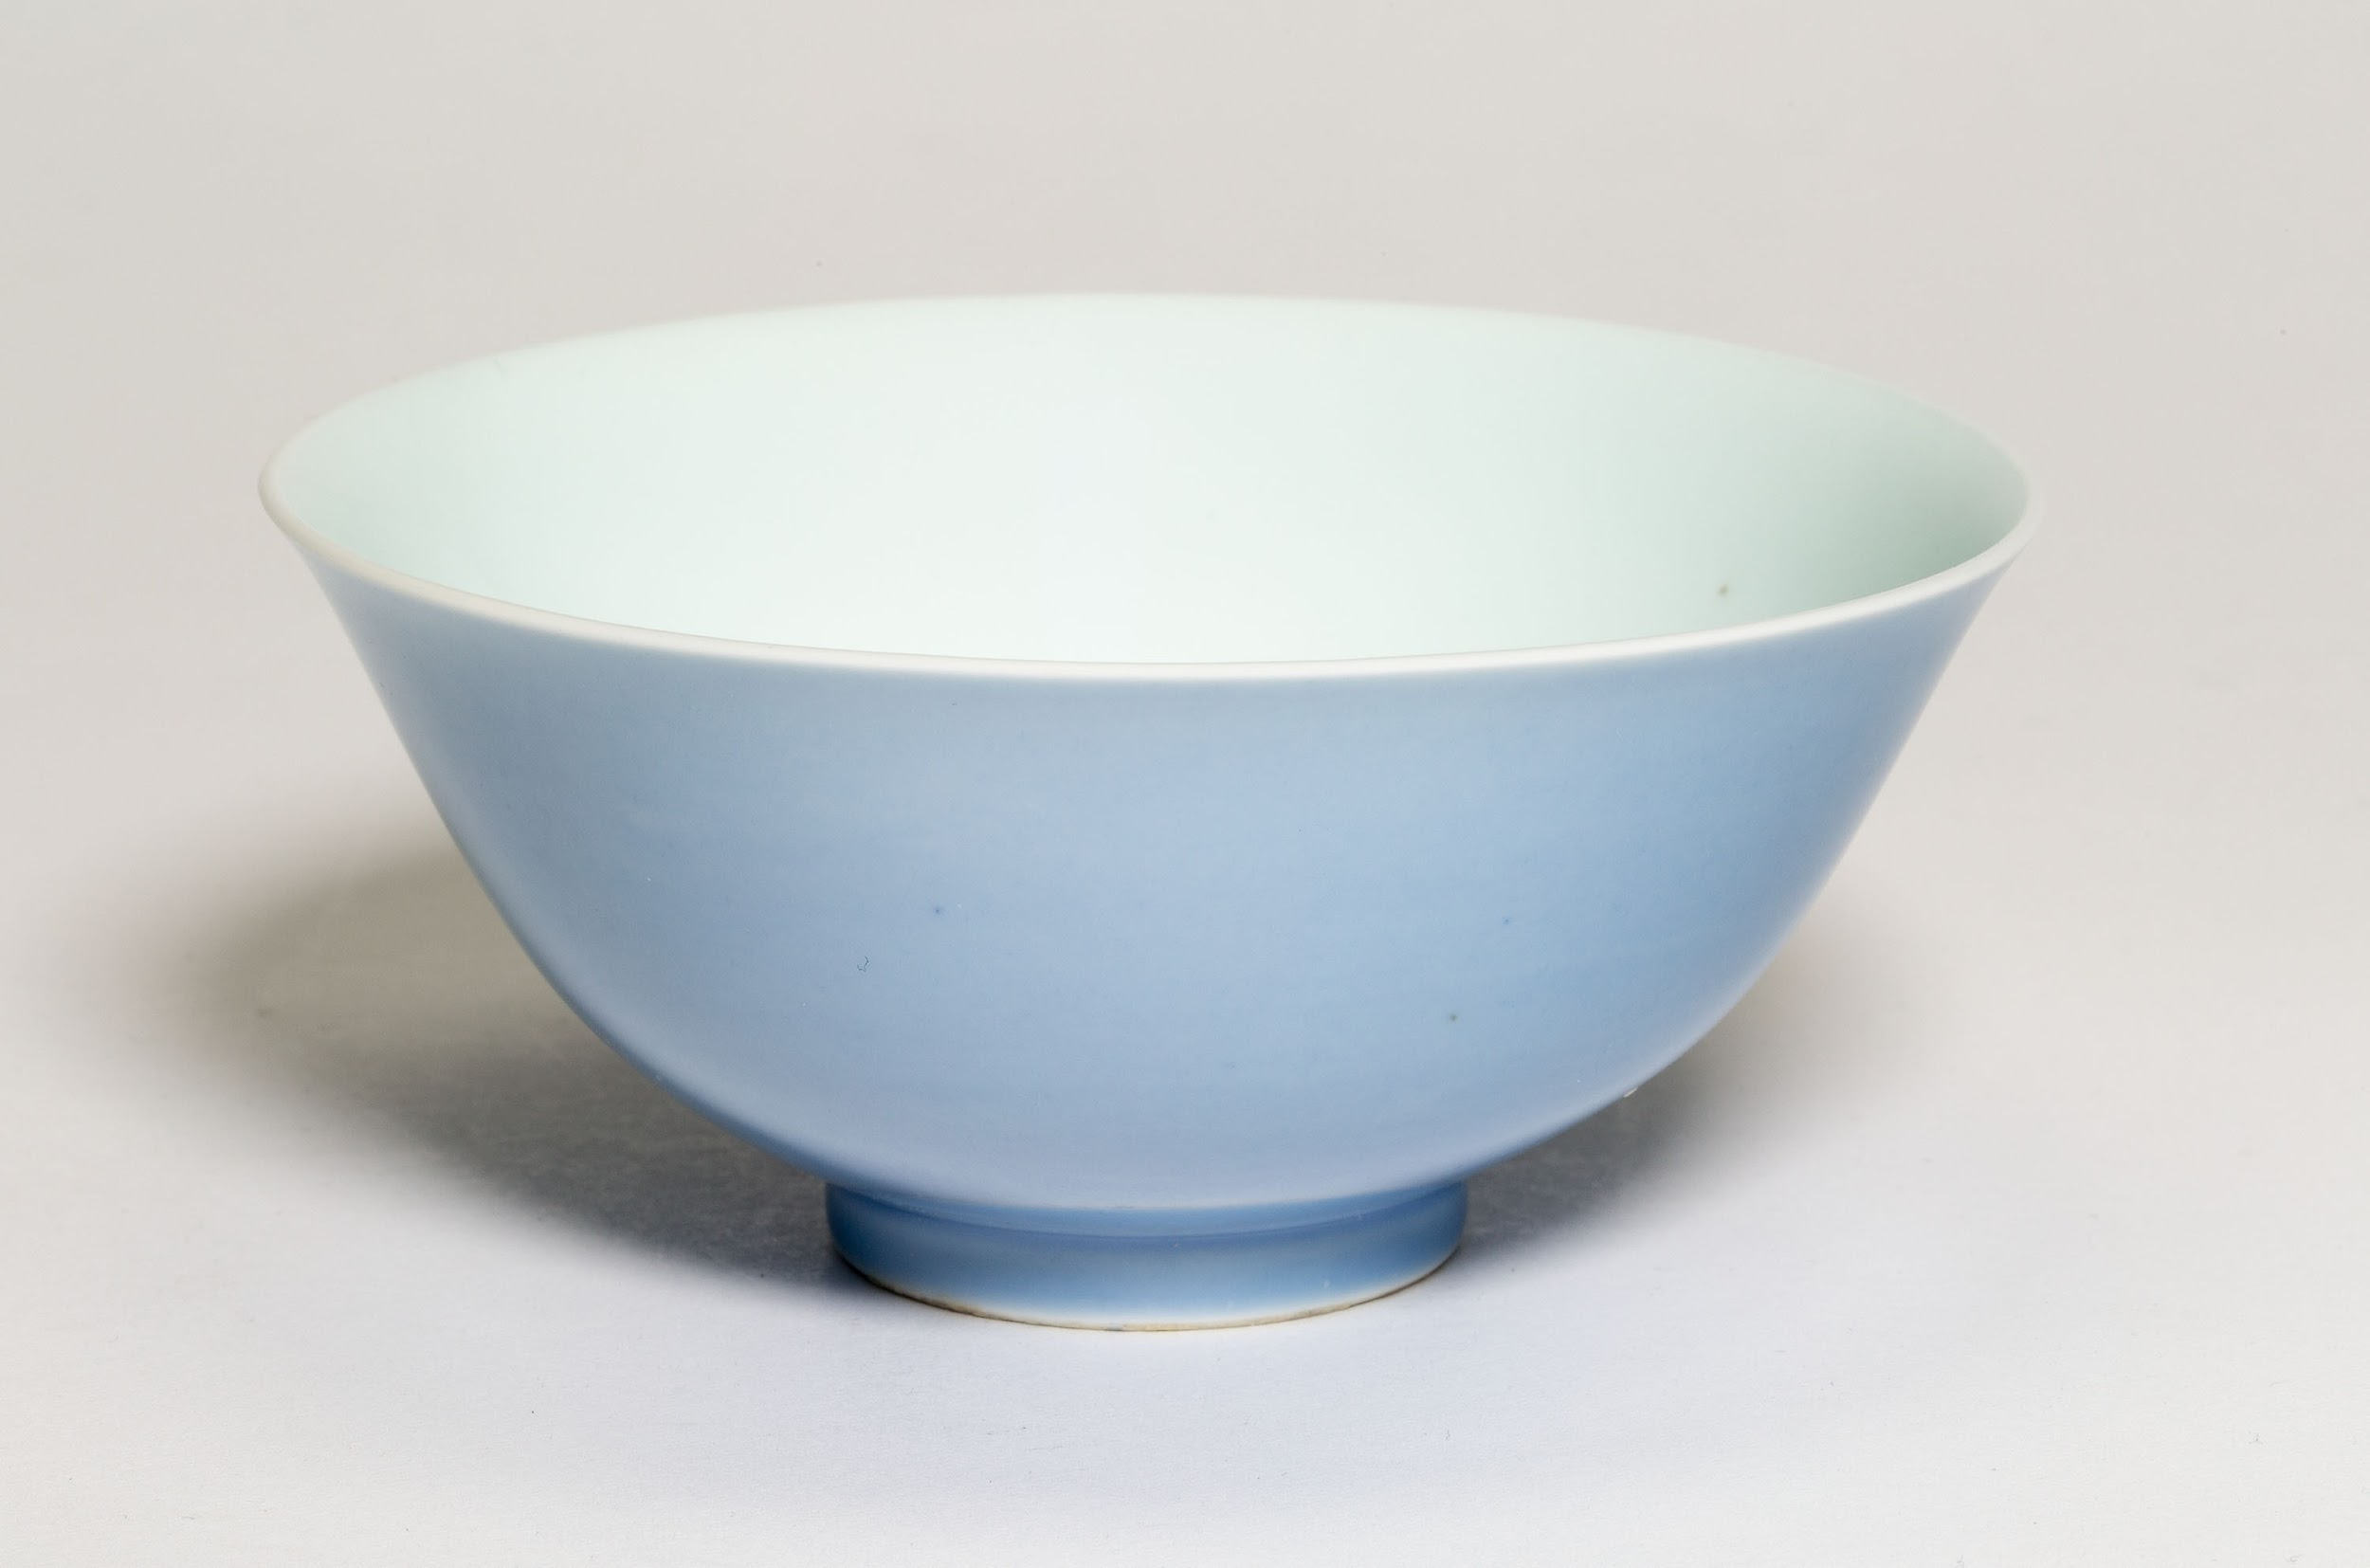

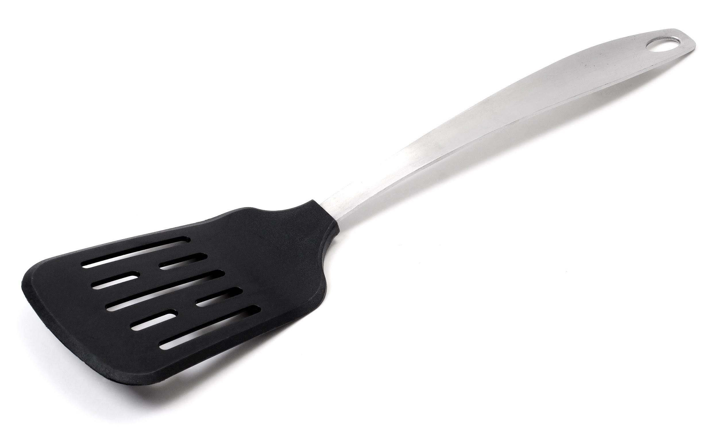
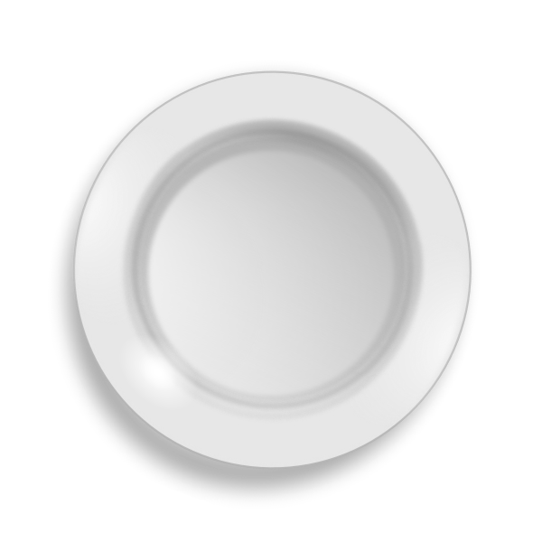
WHAT I USE ?
BOWL
FORK
FRYING PAN
STOVE
SPATULA
PLATE

Slide 16
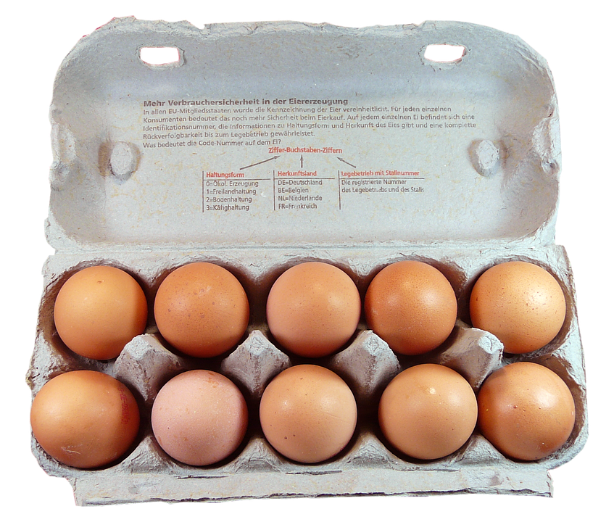
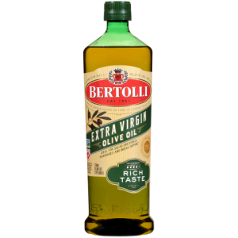
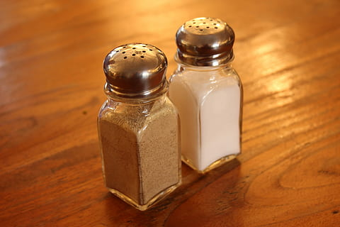
WHAT I NEED ?
SALT AND PEPPER
2 EGGS
OIL

Slide 17
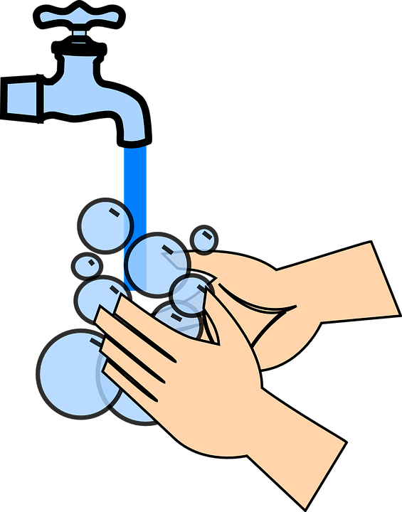
STEP- 1
We will wash hands.

Slide 18
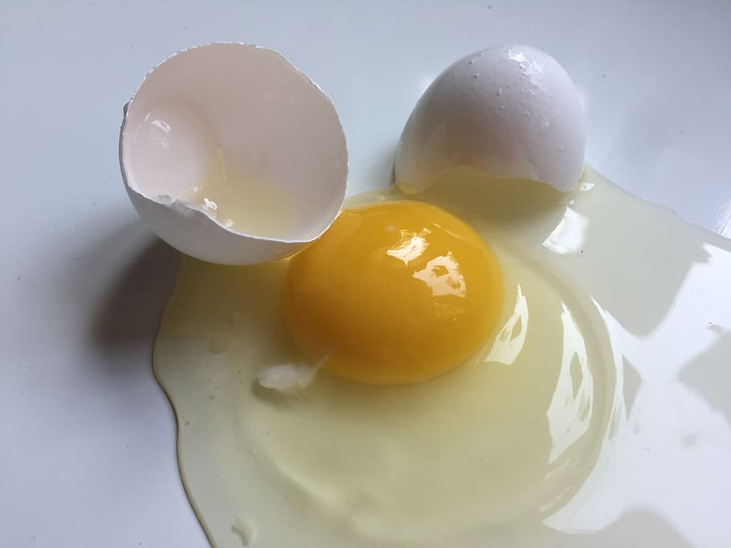
STEP- 1
STEP- 2
We will crack 2 eggs.

Slide 19
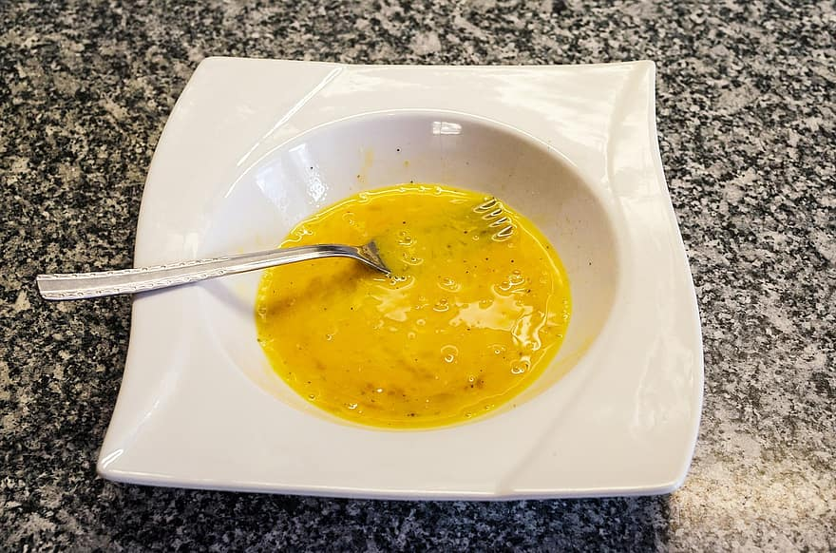
STEP- 1
STEP- 2
STEP- 3
We will beat the eggs with fork

Slide 20
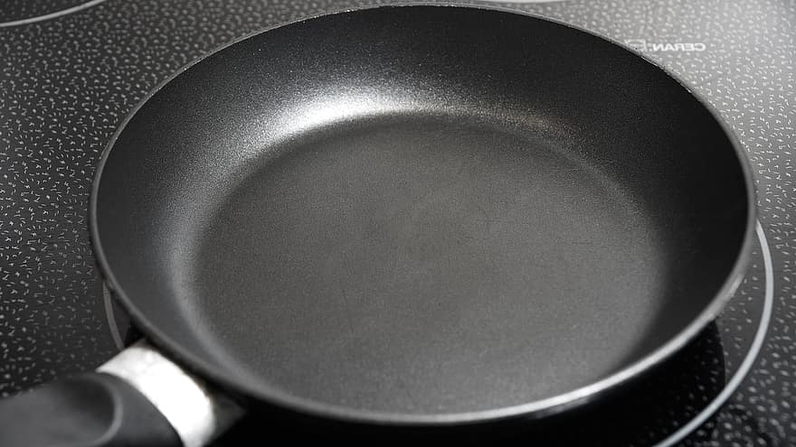
STEP- 4
Put Pan On Stove and turn on the heat.

Slide 21
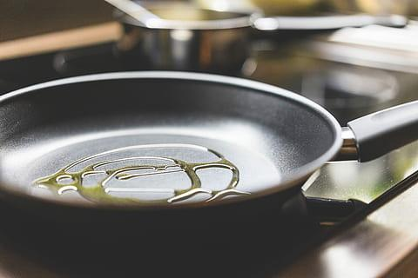
STEP- 4
STEP- 5
Oil the pan

Slide 22
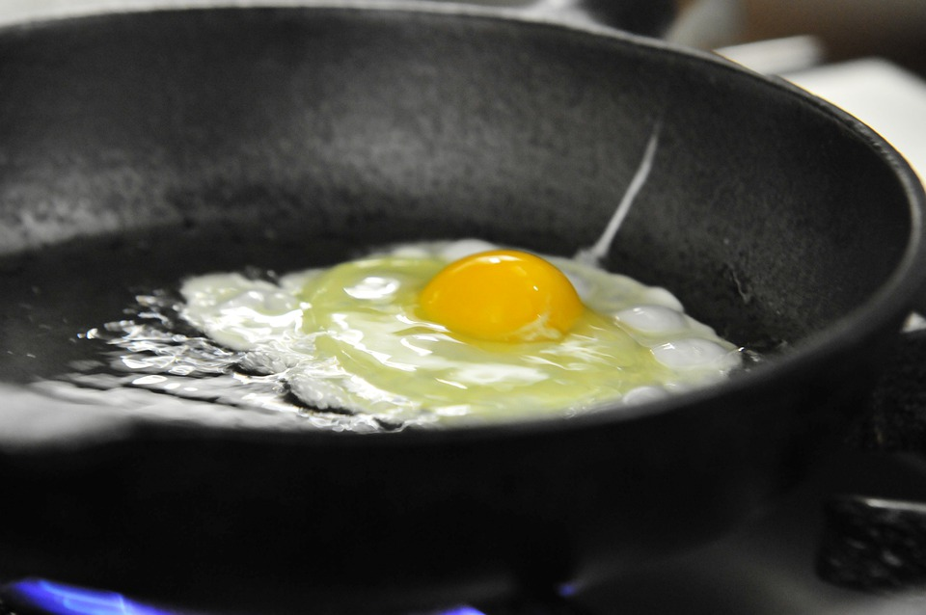
STEP- 4
STEP- 5
STEP- 6
Pour the egg mixture on the pan

Slide 23
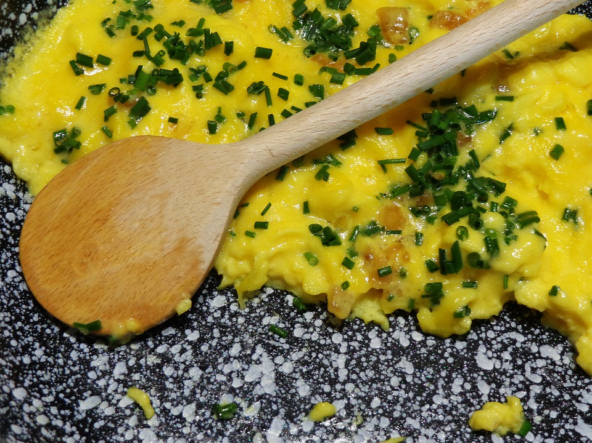
STEP- 7
Stir Eggs With Spatula until cooked.

Slide 24
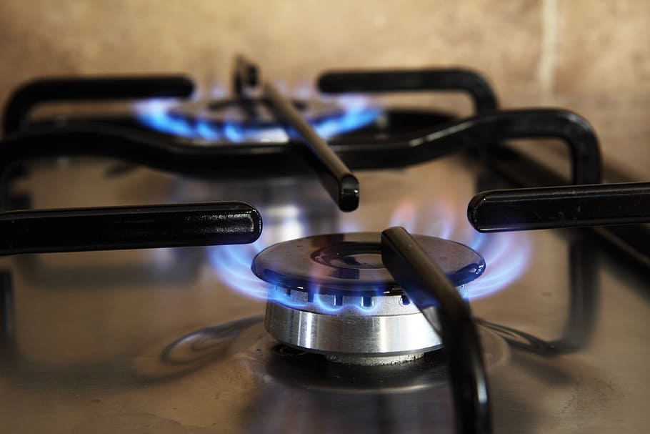
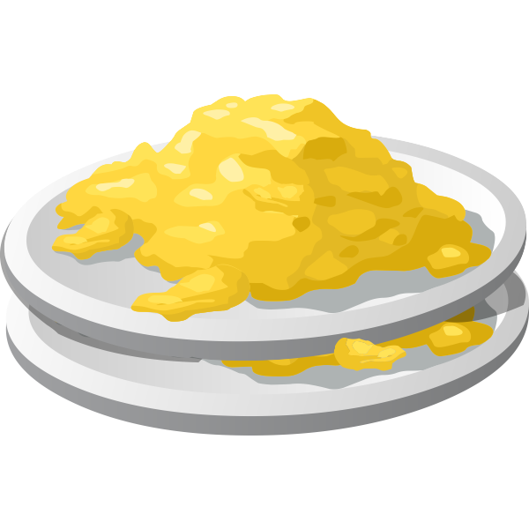
STEP- 7
STEP- 8
Turn Off Stove

Slide 25
Your scrambled eggs are ready to eat!

Slide 26
Wow ! So easy!!

